Slide 1
Lecture test Packet # 3
Control of Bacterial Growth

Slide 2
SEPSIS = bacterial contamination
STERILIZATION = the complete elimination of all microorganisms and their endospores
- complete sterilization is best achieved using an autoclave
- 121°C at 15 p.s.i. of steam for 10-15 minutes, or more depending on batch size and organic content of the media
- the temperature and not the pressure destroy the endospores
- incineration and other methods (which we will explore) can also be used to achieve sterility

Slide 3
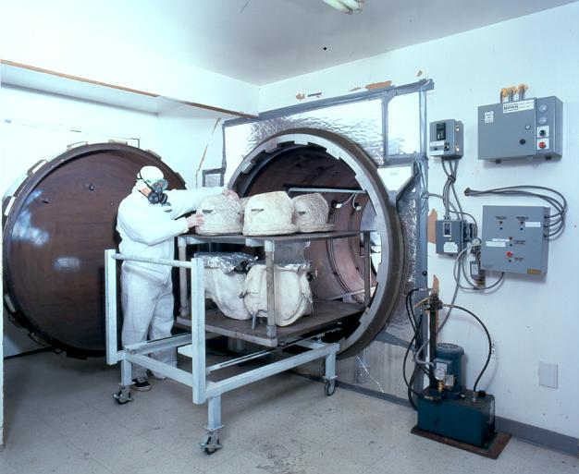
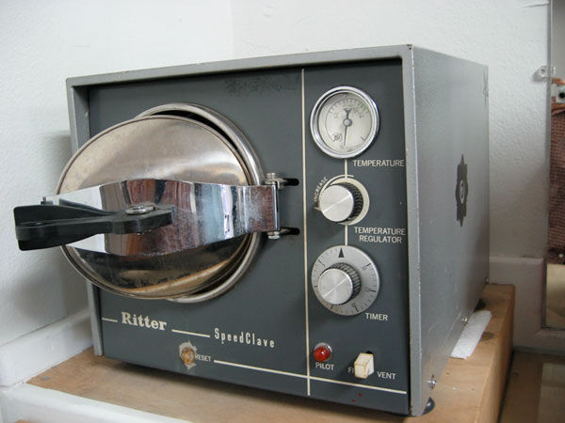
Autoclaves vary in size
Medical office desk size autoclave

Slide 4
DISINFECTION = destruction of vegetative pathogens, but nor bacterial endospores, usually on inanimate objects
ANTISEPTIC = chemicals used to destroy or inhibit the growth of vegetative pathogens, but not endospores, on living tissues
SANITATION = refers to cleaning techniques used to mechanically remove microbes from surfaces to decrease contamination
What common sanitizing agent do you hopefully use often? ☺

Slide 5
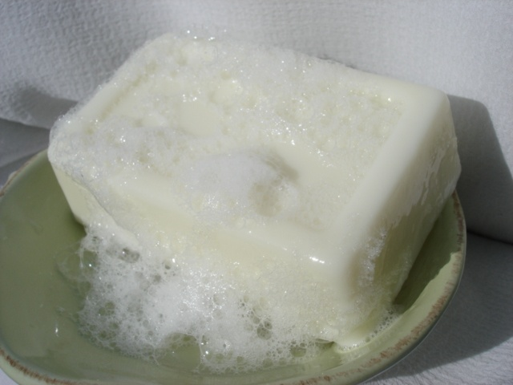

These products simply sanitize, physically removing bacteria from the surface of your skin. To become antiseptic soap, some antiseptic chemical must be added to the soap.
Bar soap
Liquid soap

Slide 6
PHYSICAL CONTROL OF MICROBIAL GROWTH

Slide 7
1. HEAT
- direct flaming, incineration and hot air can be used to sterilize
- boiling (100°C) kills many vegetative cells and viruses but may not kill endospores and therefore is not a method of sterilization!
- canning destroys endospores, but may not eliminate hyperthermophilic bacteria; canned goods are considered to be “commercially sterilized”
- pasteurization is NOT a sterilization technique!

Slide 8
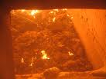
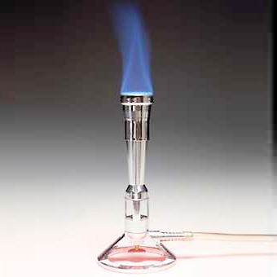
Incineration is a sterilizing method
Direct flaming is a sterilizing method

Slide 9
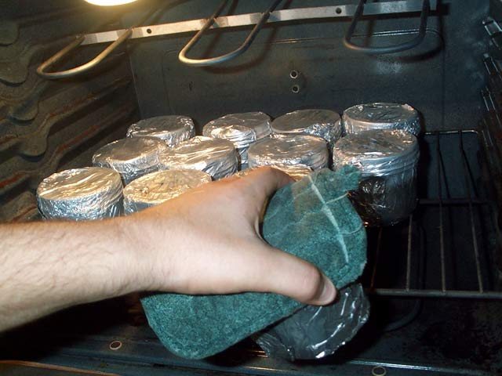
Hot air (ovens) can be used to sterilize objects.
Temperature
170 degrees C (340 degrees F) - 1 hour
160 degrees C (320 degrees F) - 2 hours
150 degrees C (300 degrees F) - 2.5 hours
140 degrees C (285 degrees F) - 3 hours

Slide 10
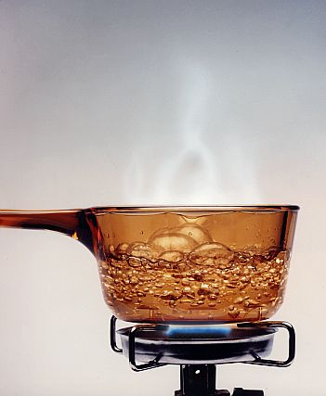
Boiling, although able to kill many microbes, isn’t considered a sterilization technique, since endospores may not be destroyed.

Slide 11
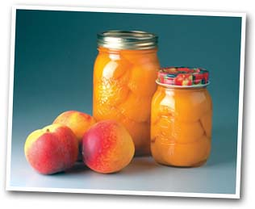
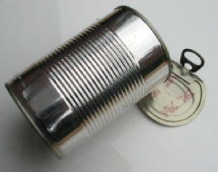
Due to the temperatures achieved in canning, all human pathogen endospores are destroyed. Canning achieves what is considered “commercial sterility” since hyperthermophiles that may survive are not human pathogens.
Home canning uses mason jars
Commercial tin can

Slide 12
There are different types of pasteurization, but they all share one thing in common. The process involves heating to destroy microbes and then a quick cooling of the item to preserve quality.
“Flash” (HTST- high temp short time) pasteurization
71.5 °C (160 °F) to 74 °C (165 °F), for about 15 to 30 seconds.
UHT (ultra high temperature) pasteurization
- 135 °C (275 °F) for a fraction of a second
- Parmalat® is “sterile milk”
- no refrigeration needed if unopened for about 3 months
Louis Pasteur’s original method was to prevent the souring of wine and beer

Slide 13
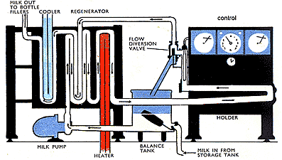
Pasteurization is simply the application of heat, to destroy potential pathogens, followed by a cooling down of the items to retain quality.

Slide 14
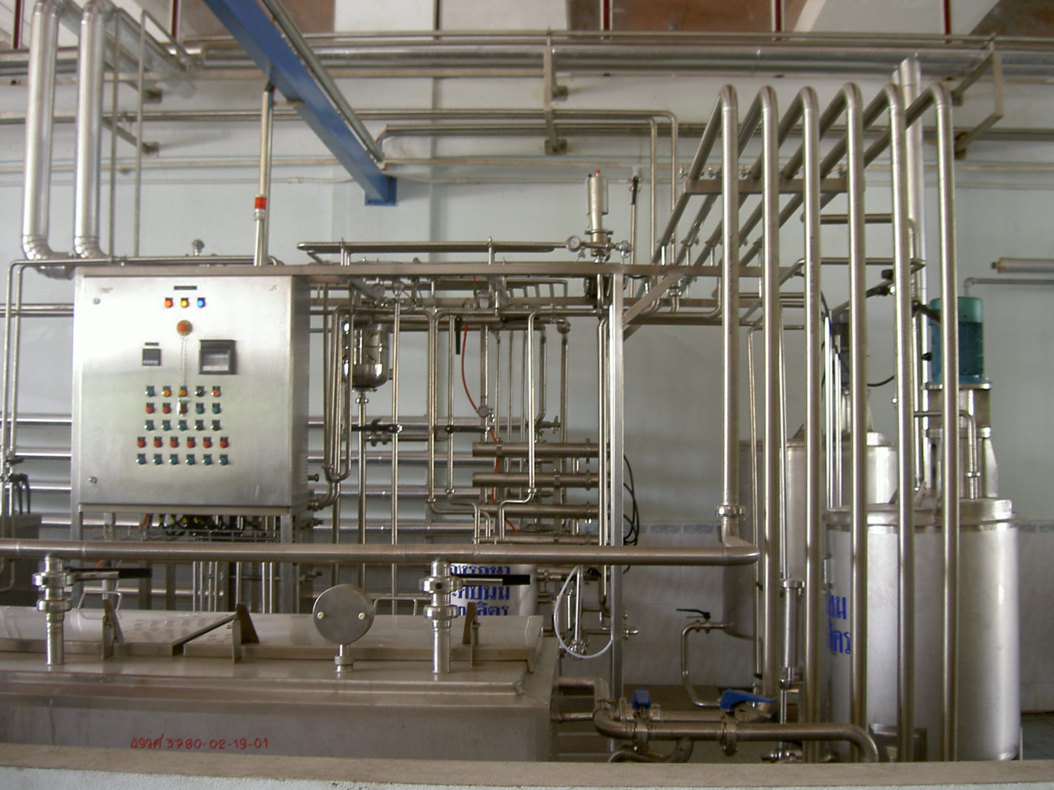
A pasteurization plant

Slide 15
Pasteurization is used to prevent the following diseases that can be transmitted from raw milk:
Mycobacterium tuberculosis
Brucella spp.
E coli O157:H7
Listeria monocytogenes
Campylobacter jejuni
Bacillus cereus
Staph aureus
Salmonella spp.
Q fever (Coxiella)
Yersinia enterocolitica

Slide 16
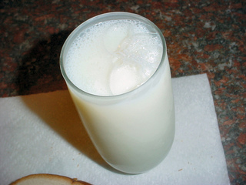
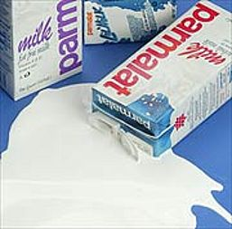
Flash pasteurized milk
UHT pasteurized Parmalat®

Slide 17
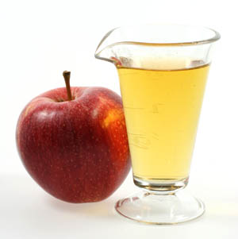
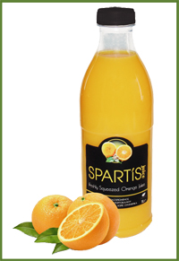
Fruit juices, like orange juice and apple juice, should always be pasteurized if you buy them from a store.

Slide 18
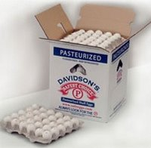
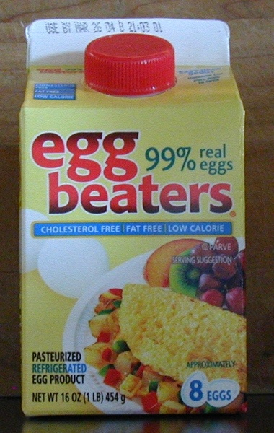
Pasteurized eggs

Slide 19
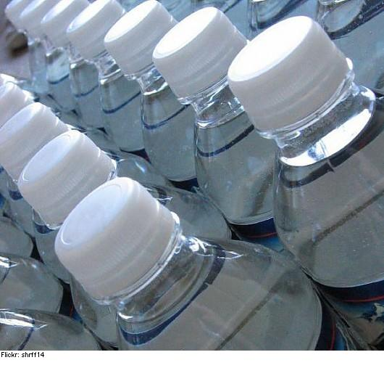

Bottled water may be pasteurized
Beer and wine is often pasteurized

Slide 20
2. COLD
- cold temperatures are usually bacteriostatic, not bacteriocidal
- “cold sterile” packs should be looked at carefully before they are thought of as a way to truly sterilize instruments

Slide 21
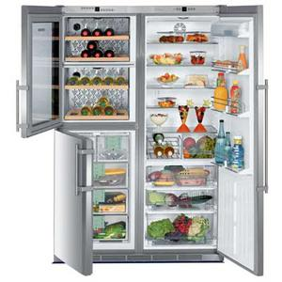
Most microbes do not die in the cold environments.

Slide 22
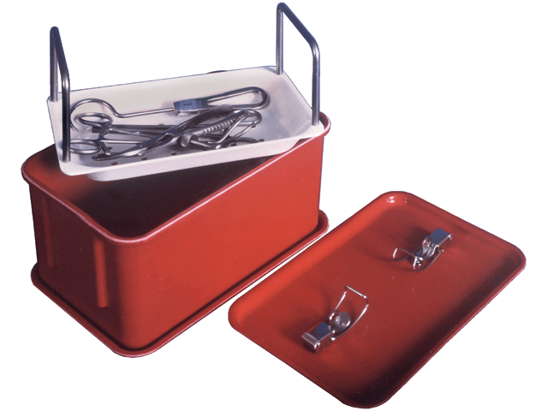
Be wary of instruments “sterilized” in a cold sterilizing system.

Slide 23
3. DESICCATION
- some organisms can persist, but not grow, without water
- viruses and endospores are often resistant to the effects of desiccation (drying out)

Slide 24
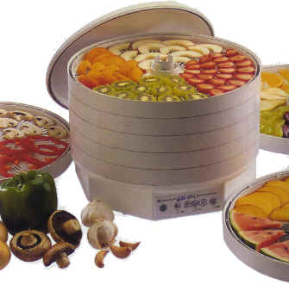
Many people use a desiccator to make dried foods.

Slide 25
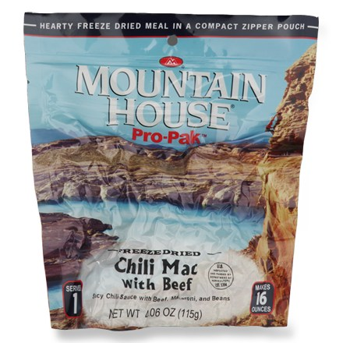
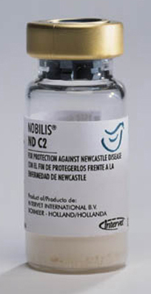
4. LYOPHILIZATION
- “freeze-drying”
- this is not a sterilizing technique
Vaccines are commonly lyophilized
Many foods are lyophilized

Slide 26
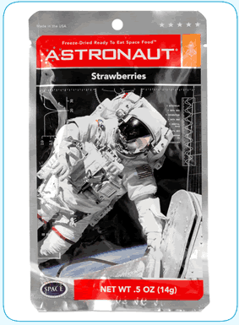
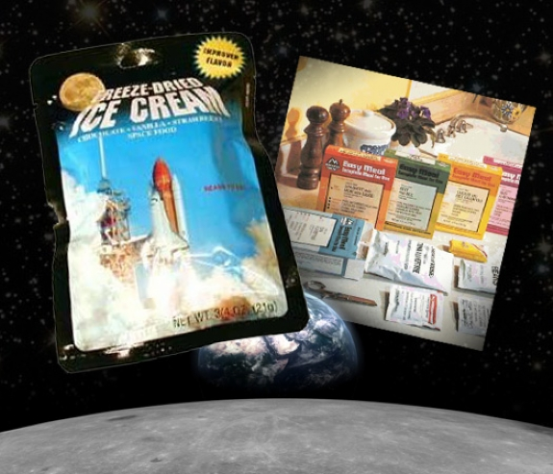
Children often love the freeze dried foods that astronauts eat.

Slide 27
5. OSMOTIC PRESSURE
- plasmolysis occurs to bacteria that are put in a hypertonic solution (high salt or sugar solutions, for example)
- molds and yeast are more likely to grow in high sugar solutions than are bacteria

Slide 28
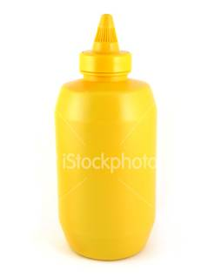
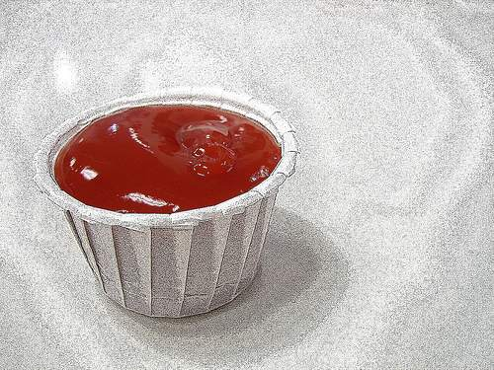
Do you worry about food poisoning from these high osmotic content foods?
Mustard
Ketchup

Slide 29
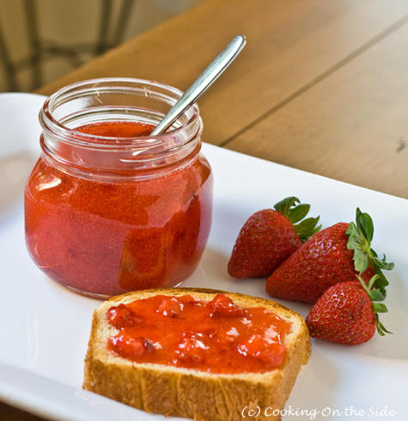
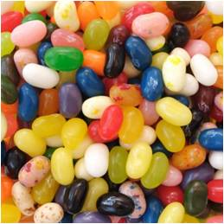
Do you worry about food poisoning from these high sugar content foods?
Jelly and Jam
Jelly beans

Slide 30
6. CAVITATION
- high frequency sound waves in a disinfectant filled device called a sonicator
- good to dislodge blood and materials from various objects (medical instruments, jewelry)
- small microbubbles form on the surface of objects in the sonicator and produce turbulence; theoretically these bubbles as they burst break apart bacterial cells

Slide 31
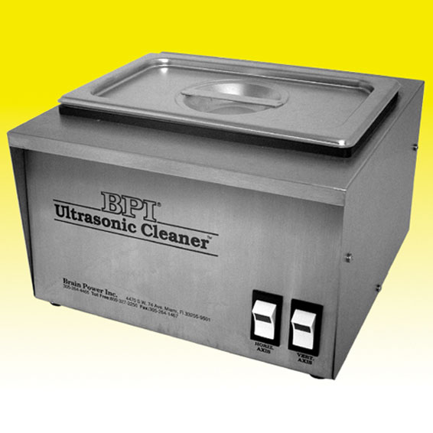
Sonicator

Slide 32
7. FILTERS
- passage of liquids and gases through some filters with extremely small pore sizes can trap microbes and their endospores and therefore may be able to sterilize
- HEPA (high efficiency particulate air filters) are used in hospitals and in vacuum cleaners very commonly to remove dust particles, pollen and other impurities from the air (they don’t sterilize though)

Slide 33

Not just any filter can sterilize; the pores must be small enough to trap bacterial endospores. Your home water filter, HEPA filters and coffee filters don’t sterilize.

Slide 34
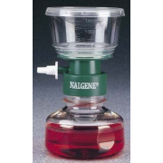
Urea broth is made using a sterilizing filtration system.

Slide 35
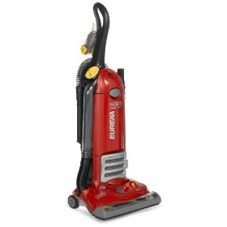
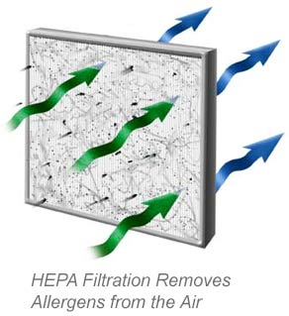
HEPA filters, although not able to sterilize, do remove many impurities from air.
HEPA filters are found on many air conditioning systems
Some vacuum cleaners have a HEPA filter as a selling feature

Slide 36
8. RADIATION
- ionizing radiation from gamma radiation is used to damage DNA of microbes on foods such as produce, meats and spices and can be used to achieve complete sterilization
- non-ionizing radiation in the form of ultraviolet (UV) light does not penetrate solids and is not a sterilizing, and is used to kill bacteria on work surfaces, water and utensils
- microwaves do not destroy bacteria directly, but the heat they produce does kill bacteria (but not endospores)
- visible light has a negative effect on the growth of some microbes

Slide 37
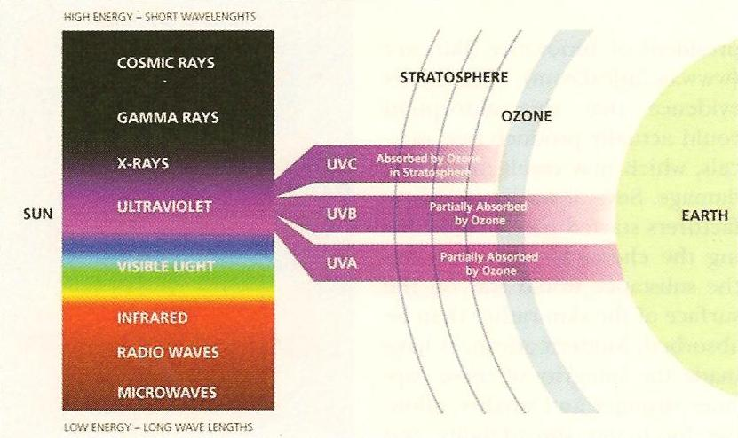
Various forms of radiation

Slide 38
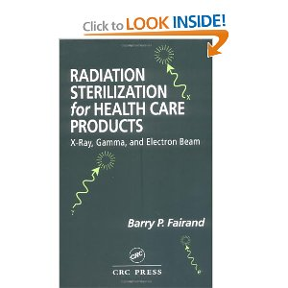
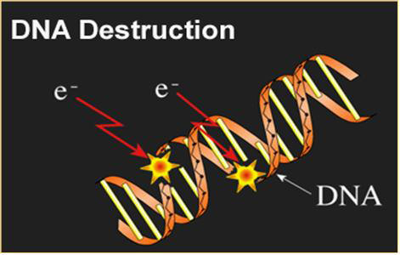
Gamma radiation can penetrate the bacterial endospore spore coat and destroy the DNA, causing sterilization.

Slide 39
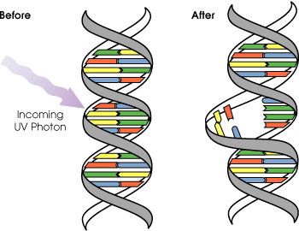
Ultraviolet (UV) rays are poorly penetrating. They can kill bacteria by producing DNA mutations (pyrimidine dimers) in live cells but the rays do not penetrate the spore coat and therefore don’t cause sterilization.

Slide 40
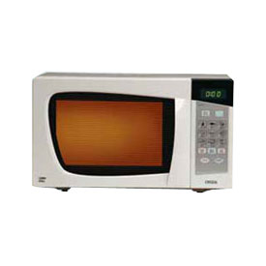
Microwaves do not kill bacteria directly, the heat they produce may kill some bacteria but not endospores.

Slide 41
FOOD MICROBIOLOGY

Slide 42
FOOD SPOILAGE BACTERIA ≠ FOOD POISONING BACTERIA
Food spoilage is any change in the visual appearance, smell or taste of a food that makes it unacceptable to the customer.
Food spoilage doesn’t necessarily mean that food is unsafe to eat ☺.
PUTREFACTION = the spoilage of proteins
FERMENTATION = the spoilage of carbohydrates
RANCIDITY = the spoilage of fats

Slide 43
To prevent food spoilage, many chemicals can be used and are added to food, including:
- salt and sugar (cause plasmolysis)
- alcohols are added to flavoring extracts
- antibiotics are sometimes added to cheese, chicken, fish and shrimp
- organic acids (lactic, benzoic, propionic acids) are used to decrease mold growth and some bacterial types of food spoilage
- sorbic acid prevents the growth of mold in cheese and soda
- nitrogen salts are added to maintain the color in red meats, inhibiting Clostridium botulinum germination
- sulfites are added to wines, juice and dried fruit to retard mold growth
- ethylene and propylene oxide gases

Slide 44
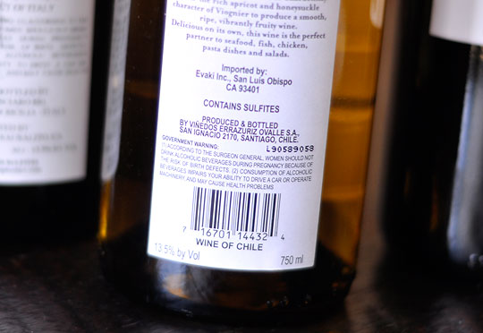

Many foods, including wine, contain sulfites to preserve them. Unfortunately some people get severe headaches from sulfites, while others can have allergic responses to them.
READ LABELS!

Slide 45
Many foods contaminated with food poisoning bacteria
DO NOT CHANGE the appearance, taste or smell of food; that’s why you eat them.
- some microbes cause food poisoning infections
(where the bacteria themselves must be present in the food to make you sick)
- some microbes cause food poisoning intoxications
(the bacterial toxins need to be present in the food, the bacteria themselves can be killed)

Slide 46
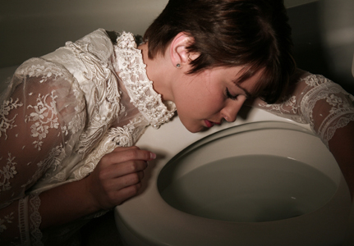

Food poisoning isn't fun ☹

Slide 47
A) Staphylococcus aureus
- occurs 1-6 hours after eating the food; it is a food poisoning intoxication
- severe nausea, vomiting, mild diarrhea, usually no fever
- produces an enterotoxin that is NOT destroyed by normal cooking temperatures
- come commonly from contaminated hands, is found in some humans’ nasal flora
- often found in custards, cream filled pastries, hams and dressings

Slide 48
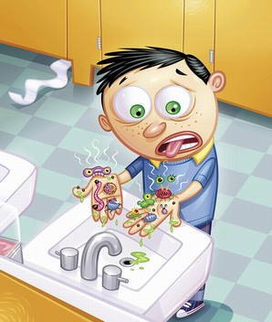
Your hands and nasal flora may be a source of staphylococcal food poisoning, which is often referred to commonly as the “24 hour flu” even though it is not the flu.

Slide 49
B. Clostridium botulinum
- “botulism” is a food poisoning intoxication
- these bacteria produce a neurotoxin that can only be destroyed by very high heat
- initially patients have blurred vision, difficulty swallowing or speaking
- occurs commonly in home canned foods
- in the United States, infant botulism is the most common type ( about 60 cases annually) and is the reason newborns are warned against eating what food?

Slide 50
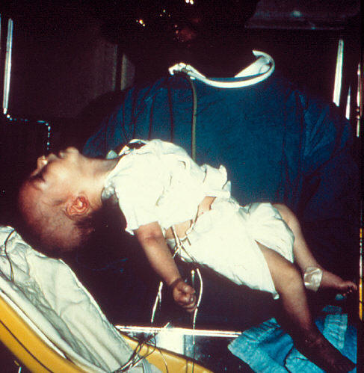
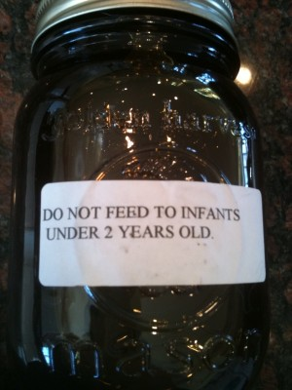
Infant botulism is sometimes linked to spores found in foods like honey. Read any honey label and you will see the same warning as you see below.

Slide 51
C. Salmonella enterica (many subspecies)
- the second most common food poisoning in the U.S.
- signs and symptoms occur 12-48 hours after ingestion of food and is a food poisoning infection that can last from 2-5 days
- signs and symptoms include sudden abdominal pain, watery diarrhea, nausea and vomiting, moderate fever
- to prevent the problem, cook your food thoroughly
- raw and undercooked eggs (egg nog, Caesar salad dressing, homemade ice cream, cake batter and cookie dough, mayonnaise, sunny side up eggs); remember you can buy pasteurized eggs
- other sources include meat (particularly chicken), dairy, fruits and vegetables
- pet reptiles (turtles, snakes, iguanas) are also a potential source

Slide 52
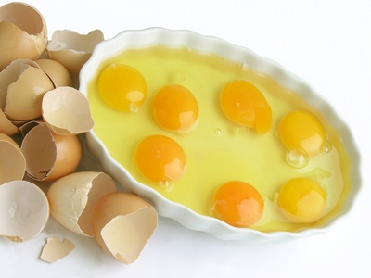
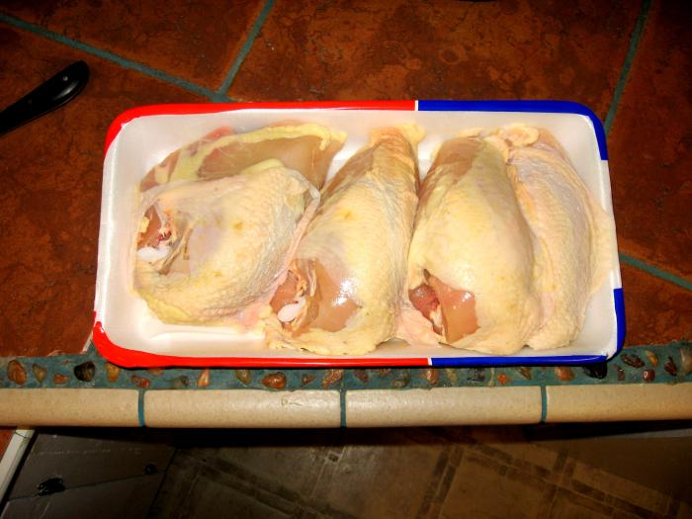
Good sources of salmonella food poisoning.
Eggs
Chicken

Slide 53
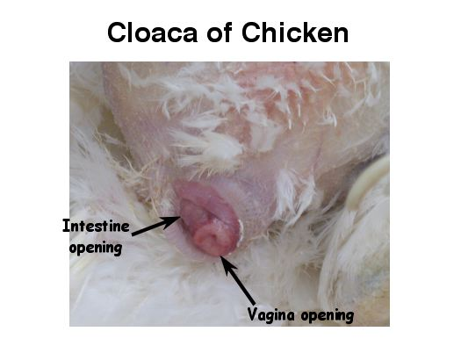
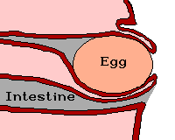
The egg of birds and reptiles exits through the cloaca, and is often contaminated with feces.

Slide 54
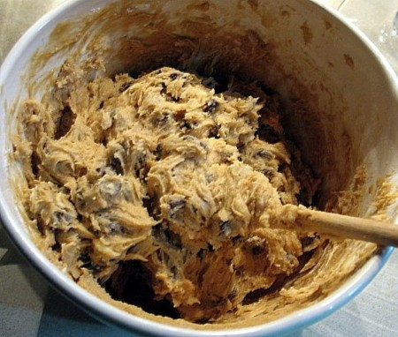
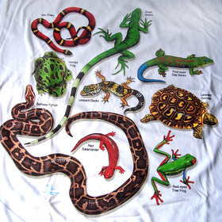
Raw cookie dough and cake batter made with raw eggs can cause salmonella food poisoning
Wash your hands before eating if you handle a reptile.

Slide 55

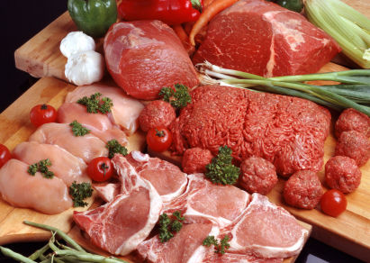
Sudden abdominal pain is common with salmonella food poisoning
Foods that can be associated with salmonella food poisoning

Slide 56

D. Campylobacter jejuni
- most common food poisoning infectious cause of diarrhea in the U.S.
- raw and undercooked meats, raw (unpasteurized) milk, untreated and contaminated water (and foods irrigated or washed with this water) are all sources

Slide 57

E. Shigella spp.
- third most common cause of food poisoning in the U.S.
- bacillary dysentery (bloody mucousy diarrhea)
- salads, milk and dairy products, contaminated water are all common sources of this food poisoning infection

Slide 58
F. Listeria moncytogenes
- common in soil and water where contamination is easy
- STORCH organism which can lead to miscarriage and still born delivery
- diary products, raw and undercooked meats, seafood and produce are all sources

Slide 59


Slide 60


G. Escherichia coli strain O157:H7
- enterotoxigenic strain of E. coli
- undercooked meat, raw milk, unpasteurized juice and water, petting zoos, raw vegetables

Slide 61


Petting zoos have been a source of E. coli O157:H7
Many raw vegetables can harbor E.coli O157:H7

Slide 62


H. Bacillus cereus
- produces a toxin and is common in rice dishes

Slide 63

I.Vibrio vulnificus and Vibrio parahemolyticus
- commonly from raw and undercooked seafood
- V. vulnificus toxins can cause a primary septicemia
- V. parahemolyticus less severe causing watery diarrhea, abdominal cramps, vomiting, fever with chills

Slide 64

Shellfish are a common source of vibriosis, they filter feed in the water.

Slide 65
J. Norwalk virus (now known as norovirus diarrhea)
- nausea, vomiting , stomach cramps, diarrhea
- waterborne food poisoning commonly from shell fish and fin fish and contaminated water
- has a history of being reported in massive epidemics on cruise ships, but the source is from people on land, where the microbes are common
There are other sources of food poisoning, we just mentioned some of the more common or serious here in these notes.

Slide 66


Wash your hands and use hand sanitizers liberally when on a cruise ship to help prevent norovirus diarrhea.

Slide 67

Steps You Can Take to Prevent
Food Poisoning in the Home

Slide 68

1. Cook meats thoroughly until the juices run clear.
- use a meat thermometer

Slide 69

2. Wash your hands thoroughly with soap and water before beginning food preparation, after handling food (particularly meat), and after going to the restroom.

Slide 70

Wash and brush off fruits and vegetables before serving.

Slide 71

Kitchen cloths should be washed often, particularly after cleaning up a spill.
Kitchen sponges can be micro waved, WHEN WET, or put into the dishwasher to reduce bacterial contamination.

Slide 72

3. Use separate cutting boards, one for raw meat, another for other foods.
- thoroughly wash cutting boards and utensils in hot soapy water.
- what kind of cutting board is the best?

Slide 73

4. Keep meat separate from other foods and items in grocery bags.
- don’t let juices of poultry or raw meat come in contact with other foods
- always marinate food in the refrigerator

Slide 74
5. Freeze meat immediately when you arrive home.
- thawing rules: thaw foods preferably in the refrigerator and not on the counter or in the sink
- sink thawing should only be done if the food is completely immersed in COLD water
- microwave thawing should only be done if the meat is to be cooked immediately afterwards
- store foods in small containers in the refrigerator and allow air to circulate around each food container (don’t pack your refrigerator full of food)

Slide 75


HAPPY THANKSGIVING!!!
This holiday is considered by many to be our national food poisoning holiday ☺
Don’t stuff your bird!!
You may end up here ☹

Slide 76
6. Don’t consume meat that has been left out for over 2 hours; if you want to eat it, cook it again to be safe.
- hot foods need to be kept over 135°F
- cold foods need to be kept under 40°F

Slide 77


Slide 78

Don’t taste foods you suspect are going bad to “test them”
REMEMBER, IF IN DOUBT, THROW IT OUT ☺

Slide 79


CHEMICAL CONTROL OF MICROBIAL GROWTH
Some chemicals commonly used on the body or on inanimate objects include:

Slide 80
1) PHENOL (carbolic acid) and related compounds
- used by Lister to decrease infections due to surgical wounds
- this is the standard chemical to which all other disinfectants are compared
- spores are resistant
- bisphenols, such as Triclosan (controversial) and hexachlorophene (pHisoHex) are used in antiseptic soaps, skin lotions and many products

Slide 81


Bisphenols are used commonly as antiseptics in many products that you use daily.
Many products contain triclosan, although this chemical is now becoming somewhat controversial
Hexachlorophene (pHisoHex)

Slide 82
2) ALCOHOLS
- 70-90% ethanol (ethyl alcohol) = grain alcohol
- 40-80% isopropyl alcohol = rubbing alcohol
- spores are resistant
- often used to clean skin prior to needle “sticks”

Slide 83

According to the CDC, to be effective, hand sanitizing gels must be moist on the skin for 10-15 seconds before they dry out.
Many hand sanitizing gels contain ethyl alcohol.
Rubbing alcohol, from your pharmacy, is isopropyl alcohol.

Slide 84
3) HALOGENS a) IODINE – the most effective skin antiseptic
- tinctures vs. aqueous solutions
- pure strength iodine is sporocidal, fungicidal, viracidal and amoebacidal
- pure strength iodine is also very irritating to the skin so instead we use iodophores, like betadine and povidone iodine scrubs, which although not full strength and not sporocidal, cause less tissue irritation and less staining

Slide 85

A tincture of iodine, is iodine dissolved in alcohol. Aqueous solutions of iodine are water based.

Slide 86


Common iodophore commercial products; iodine is the BEST skin antiseptic.

Slide 87
b) CHLORINE
- chlorine bleach and water make an excellent disinfectant solution for the kitchen and bathroom
- water treatment facilities often use chlorine

Slide 88


Chlorine bleach makes an excellent disinfectant spray for home use in the kitchen and bathroom.

Slide 89

4) HEAVY METALS
NO!!! Not heavy metal bands!

Slide 90

- Hg (mercury)
Mercurochrome was commonly used as a skin antiseptic

Slide 91


Zn (zinc)
Zinc chloride is in some mouthwashes
Zinc oxide is found in some athlete's foot medication

Slide 92


Cu (copper)
- is used for algae control

Slide 93


Ag (silver)- used on catheters, surgical dressings and burn creams; silver nitrate sticks are used to cauterize small cuts
Burn creams can contain silver nitrate
Silver nanotechnology burn gel

Slide 94
5) DETERGENTS
- soaps are good sanitizers, they aren’t actually disinfecting or antiseptic as the kill very few bacteria
- Pseudomonas can grown in soap dishes!!

Slide 95


Pseudomonas spp. often produce a green pigment.

Slide 96
6) QUATS (quaternary ammonium compounds)
- antiseptic for skin, disinfectant used for medical instruments, utensils and rubber goods
- not sporocidal and Mycobacterium tuberculosis as well as Pseudomonas spp. are resistant

Slide 97


QUATS
Benzalkonium chloride is found in these products.

Slide 98

QUATS

Slide 99
7) ALDEHYDES
- disinfectants
- formaldehyde (formalin in an aqueous form that is used to preserve biopsy specimens)
- glutaraldehyde (CIDEX®) used to disinfect some medical instruments such as those used in respiratory therapy

Slide 100


Aldehydes are good disinfectants.
Formaldehyde is commonly used to preserve tissues. (carcinogenic)
Glutaraldehyde in a cold sterile container.

Slide 101
8) PEROXYGENS
- ozone (O₃) is used to disinfect some municipal water supplies
- benzoyl peroxide – used in acne creams, hair dyes and tooth whiteners
- H₂O₂ is a poor antiseptic but a good disinfectant (contact wearers sometimes use hydrogen peroxide to clean the lenses)
- plasma gas sterilization uses H₂O₂ vapors irradiated with radio or microwaves to make a sterilizing plasma gas

Slide 102

Hydrogen peroxide can retard wound healing – use it as directed by your doctor for wounds.

Slide 103


Plasma gas sterilizer
Plasma gas treatment of gloves

Slide 104
9) DYES, ACIDS and ALKALINES
- crystal violet and other dyes can be used to treat skin infections
- peracetic acid (0.2%) is a sterilizing chemical used in some sterilization systems
- NaOH (alkaline)
In today’s medical environment, it is not only important to destroy viruses and spores, it sometimes is also important to destroy prions. Autoclaving, irradiation and most chemicals by themselves do not appear to be able to destroy prions; boiling NaOH and autoclaving combined does destroy prions though.

Slide 105
10) ETHYLENE OXIDE and PROPYLENE OXIDE GASES
- bacteriocidal and sporocidal
- can pass through fabrics and some plastics
- useful to sterilize delicate surgical instruments
- is used on dried fruits and spices
- has been used to sterilize some items in the space program

Slide 106

Ethylene oxide gas, and now propylene oxide gas can penetrate fabrics and some plastics to sterilize.

Slide 107
CHEMOTHERAPEUTIC AGENTS

Slide 108
The goal of chemotherapy is to find drugs which will treat the patient and not harm them = SELECTIVE TOXICITY
Most chemotherapeutic agents fall short of being ideal because they: a) have undesirable side effects b) they lead to the elimination of parts of your normal flora c) they lead to the formation of antibiotic resistant strains of bacteria

Slide 109


The first chemical synthesized in a lab and made to treat a disease was SALVARSAN.
- Paul Ehrlich produced it in the early 1900’s
- this was the 606th arsenic compound that he tested and was used to treat syphilis

Slide 110


In 1929, Alexander Fleming discovered PENICILLIN.
- it was used during WWII to significantly reduce the deaths of soldiers
- this was the FIRST TRUE ANTIBIOTIC

Slide 111

1930’s SULFA DRUGS
ARE SULFA DRUGS TRUE ANTIBIOTICS?
A true antibiotic is a natural substance made by one organism to kill a microorganism.
In the 1930’s sulfa drugs were synthesized in a lab and were found to kill bacteria.

Slide 112
The ANTIBIOTIC DRUG DILEMMA http://www.youtube.com/watch?v=UZatOIWlf3Y&list=UU3bcS7-_5pTquP8oPYbXZYw&index=1&feature=plcp

Slide 113
There is an alarming rise in the numbers of microbial species that are becoming resistant to antibiotics.
(i.e. PPNG – penicillinase producing
Neisseria gonorrhoeae
MRSA – methicillin resistant
Staphylococcus aureus
VRE – vancomycin resistant Enterococcus
VRSA – vancomycin resistant
Staphylococcus aureus
MDR-TB – multiple drug resistant
Mycobacterium tuberculosis)
MDRAB- multiple drug resistant
Acinetobacter baumannii

Slide 114
A gene that makes bugs highly resistant to almost all known antibiotics, or "super superbugs," has been found in bacteria in the water supplies in New Delhi. The gene, called NDM 1, first emerged in India in 2008 and has spread across the world.
MRSA, or methicillin-resistant Staphylococcus aureus, is a superbug that alone is estimated to kill 19,000 people each year in the United States -- far more than HIV and AIDS. (2010)

Slide 115

MRSA infections are some of the more problematic antibiotic resistant infections known to occur in hospitals.

Slide 116
This rise in antibiotic resistant strains of bacteria could be due to some or all of the following:
1) over 400 million prescriptions are written every year in the U.S. and an estimated 1-2% of these are misprescribed or misread
2) many prescriptions for antibiotics are written for VIRAL infections, like the cold and flu
3) Antibiotics are over used in surgical prophylaxis

Slide 117
- they are used for the following non-medical purposes:
- as growth stimulators in poultry and livestock
- to treat bacterial diseases in plants
- to make some selective media (Thayer Martin,
Columbia CNA with 5% Sheep Blood)
- to inhibit the growth of bacteria in cell and tissue cultures
- many times no C & S (culture and sensitivity) is performed, instead a shot gun approach is taken
- broad spectrum antibiotics are often prescribed which can lead to super infections; instead a “shot gun” approach is taken

Slide 118
- out of date antibiotics are often shipped overseas and sold over-the-counter
- many people around the world cannot afford event he cheapest of antibiotics and therefore die or become disabled due to preventable or treatable infections

Slide 119
Antibiotic resistance arises from either:
- mutations occurring in single bacteria which reproduce by binary fission and pass these mutant genes on to all of their offspring
OR
- through the transmission of antibiotic resistant plasmids (R plasmids) from one bacterium to another

Slide 120
The problem should be addressed by all health care professionals and the following steps should be undertaken: a) avoid the use of antibiotics for viral infections or where there appears to be little therapeutic value (snort, sniffle, sneeze, no antibiotics please ☺) b) use antibiotics for the full length of time prescribed on the label, don’t save them for a “rainy day” ☹ c) use sufficiently high doses, sometimes in combinations d) switch antibiotics at the first signs of developing resistance; if the antibiotic doesn’t appear to be improving your systems, call your doctor

Slide 121


Slide 122


When should this patient stop taking this prescribed antibiotic?

Slide 123
HOW DO WE SELECT THE APPROPRIATE ANTIBIOTIC TO TREAT YOUR INFECTION?

Slide 124
1. First, the etiologic agent must be isolated in pure culture from the patient (wounds, urine samples, swabs, tissue samples, etc.)
2. Then, the etiologic agent from the pure culture is simultaneously: (C & S) a) identified to genus and species (CULTURE) b) examined to determine what antibiotic(s) will be able to treat the infection (and SENSITIVITY)

Slide 125


The Enterotube II is a miniaturized, rapid, multi-test system used to identify pathogenic coliforms.

Slide 126
In all cases, to determine the correct antibiotic necessary to treat a specific infection, we look to determine the MIC, or minimum inhibitory concentration of the antibiotic that will completely eliminate the infection (without killing the patient).

Slide 127
The agar diffusion method using
Mueller Hinton agar is called the Kirby Bauer technique and is a standardized method commonly used to determine
MIC values.

Slide 128

Pick the zone size that you think would best indicate a proper antibiotic to choose to treat the infection found in this bacterial lawn.

Slide 129
It turns out that since in-vitro (in glass, in experiment) and in-vivo (in the living organism) results don’t always coincide, the zones sizes on the MHA plate must be compared to a chart to see if a zone of inhibitions size is significant.
Zone sizes can fall into the resistant (R), intermediate (I) or susceptible (sensitive) (S) column. You want to choose an antibiotic that falls under the susceptible column showing that an infectious microbe is sensitive and is killed by an antibiotic in the body.

Slide 130


There are other methods to determine MIC antibiotic sensitivity values other than the Kirby Bauer technique.
Microtiter plate
E-test

Slide 131
Once the appropriate antibiotic is selected, it can be administered via various routes: p.o. = per os (orally) parenterally = by injection (subcutaneous, intramuscular, intravenous, etc. topically = on the surface (cutaneous, conjunctival)

Slide 132

Medicine given p.o. (per os) is administered orally.

Slide 133

Antibiotics administered parenterally are given through injection.

Slide 134


Topically administered antibiotics are applied to the surface of the body.

Slide 135
HOW DO COMMON ANTIBIOTICS KILL BACTERIA?

Slide 136
A) Some antibiotics affect the cell walls of bacteria.
(penicillin)
B) Some work by making bacterial cell membranes leaky. (polymyxin B)
C) Some affect protein synthesis in bacteria.
(chloramphenicol, erythromycin, tetracycline)
D) Some inhibit DNA or RNA synthesis in bacteria.
(ciprofloxacin, rifampin)
E) Some inhibit the synthesis of specific enzymes in bacteria. (sulfonamides, trimethoprim)

Slide 137
Antibiotics shouldn’t be used carelessly. Many have side effects besides becoming antibiotic resistant; some cause hepatotoxicity, nephrotoxicity, anemia, nausea, vomiting, neurologic damage, ototoxicity and other problems.

Slide 138
NOSOCOMIAL INFECTIONS

Slide 139


Slide 140
Nosocomial infections can be from any of the following:
Air, Water, Food
Medication administration (syringes)
Surgical procedures
Devices (implants, drains, catheters)
Fomites
Insects
Patient’s normal flora
Visitors
Other patients
Hospital personnel

Slide 141
The purpose in knowing about microbial growth, the use of aseptic technique and how to inhibit microbial growth is for you, the allied health student, to be aware that if you don’t think about microbes, you will often be the one spreading nosocomial infections to your patients (besides bringing “pets” home to your family and friends).

Slide 142
NOSOCOMIAL INFECTIONS are those infections patients get when they go to a hospital or other medical facility.
About 50% of nosocomial infections are due to
UTI’s (urinary tract infections)
About 25% of nosocomial infections are due to surgical wound infections
About 12% of nosocomial infections are due to lower respiratory tract infections

Slide 143
HOW CAN WE BREAK THE CYCLE OF INFECTIONS IN MEDICAL FACILITIES?

Slide 144

Proper hand washing
At least 10 seconds of soap lathered scrubbing and then rinsing.
Should be before and after EVERY patient.
In lieu of hand washing, many facilities use antiseptic hand gels; this works as long as the gel remains moist on the skin for 10-15 seconds without drying out.

Slide 145

Proper Aseptic Technique
Do not contaminate sterile items or fields by learning how to open material found in sterile packaging, by using gloves, and by using other precautions.

Slide 146


Slide 147

Isolation units
Used to keep pathogens inside a patient’s room so they don’t spread.

Slide 148


Reverse Isolation Units
Used to keep pathogens out of rooms that house patients who are immunocompromised.

Slide 149


Hospital disinfection and sterilization of fomites must be monitored to reduce nosocomial infections.
Disinfectants must be carefully chosen.
Fomites can spread infections.

Slide 150

Environmental sanitation must be monitored in order to reduce nosocomial infections.

Slide 151


Infection control committees monitor the rates of nosocomial infection within each hospital and try to correct poor practices that lead to increased rates.

Slide 152
SOME UNIVERSAL PRECAUTIONS HEALTHCARE WORKERS SHOULD FOLLOW

Slide 153

If blood or body fluids have the potential to splash on you, use the appropriate barriers to protect yourself.

Slide 154

WASH YOUR HANDS!!! before AND after each patient!!!

Slide 155


Prevent needle and scalpel sticks.
- never recap needles, never break or bend needles by hand, never remove a needle from a disposable syringe.
Biological Sharps containers

Slide 156


Minimize mouth to mouth resuscitation.
Ambu bag
CPR mask

Slide 157

Workers with weeping lesions should refrain from patient care or handling equipment.

Slide 158

Get the proper vaccinations.
- tetanus (q 10 years), hepatitis B, influenza (annually)
- childhood vaccine series should be boostered if you have a low titer

Slide 159
Read this article about wearing hospital scrubs outside the hospital environment. http://online.wsj.com/article/SB123137245971962641.html

Slide 160
LEARNING OBJECTIVES FOR PACKETS 3A and 3B
1. Understand the effects of temperature, pH, water availability and oxygen on the growth of bacteria. Be able to name types of bacteria by their affinity for different temperatures, pH levels, solute concentrations and oxygen requirements.
2. Explain the tests that can be used to determine a bacterial species affinity to different temperatures, pH levels, solute concentrations and oxygen requirements.
3. Be able to explain how bacteria get nutrients from their environment and the significance of obtaining the six major macronutrients found in living cells.
4. Be able to determine whether media is chemically defined or undefined and explain why agar is the ideal solidifying agent in solid microbiological media.
5. Know the purpose for using the various general purpose, enriched, selective and differential media in the notes. Be able to give examples of each type of media as well as how and why each medium works to achieve its purpose.
6. Be able to draw a bacterial growth curve for bacteria being grown in a closed system and explain why the bacterial numbers change during each phase of the graph; if given a culture of bacteria, be able to give several methods of keeping the bacteria alive for 6 months or more.
7. Be conversant about how enzymes work in living systems.

Slide 161
8. Be able to give a simple explanation of how and when photosynthesis occurs to produce oxygen; compare and contrast oxygenic and anoxygenic photosynthesis.
9. Be able to give the three steps of aerobic cell respiration and locate where each step occurs in prokaryotic vs. eukaryotic cells. Be able to account for the 38 ATP molecules that are produced during these reactions in prokaryotes. Explain the reason that the average bacterium can get more ATP from a molecule of glucose than you can.
10. Compare and contrast aerobic cell respiration with ethyl alcohol and lactic acid fermentation.
11. Compare and contrast the terms antiseptic, disinfectant, sanitation and sterilization.
12. Explain how some forms of heat can be used to sterilize while other forms cannot.
13. Be able to describe how pasteurization is done, why it is done and give examples of foods that are pasteurized besides milk and dairy products.
14. Explain why cold temperatures are bacteriostatic but not typically bacteriocidal.
15. Compare and contrast the usefulness of desiccation, lyophilization, the use of salt and sugar as preservatives, cavitation, filters and various types of radiation in sterilization.
16. Explain the difference between food poisoning and food spoilage; explain the difference between food poisoning intoxications vs. infections.

Slide 162
17. Be familiar with the array of chemicals used to preserve food from spoiling.
18. Compare and contrast food poisoning due to Staphylococcus aureus, Clostridium botulinum, Salmonella enterica, Campylobacter jejuni, Shigella, spp., Listeria monocytogenes, E. coli strain O157:H7, Bacillus cereus, Vibrio spp., and noroviruses.
19. Be able to teach others how to prevent food poisoning in the home.
20. Give examples and compare and contrast the uses of phenol compounds, alcohols, halogens, heavy metals, detergents, quats, aldehydes, peroxygens, dyes, acids, alkalines, and ethylene and propylene oxide gases.
21. Explain what is meant by selective toxicity and tell about the early history of chemotherapeutic agents in curing infectious disease.
22. Explain why we have an antibiotic drug dilemma; know about common antibiotic resistant bacteria in hospitals. Explain how bacteria become antibiotic resistant , how we can help solve the problem and how do we select and administer the appropriate antibiotic for each patient’s individual infection.
23. Know the general ways in which antibiotics kill bacteria and why antibiotics aren’t useful in treating viral infections.
24. Be familiar with the potential sources of nosocomial infections in hospitals.
25. Explain how nosocomial infections can be minimized in hospitals.
26. Explain the universal precautions you will be taking to prevent getting infections while working in a hospital.

